Slide 1

Using Tweak to Study Ccrypt
(using a text editor to study plain and encrypted text)
Dave Mawdsley,
DACS Member, Linux SIG
December 19, 2012

Slide 2
Installing Tweak and Ccrypt
1
Using the command line, issue the following command to install tweak and ccrypt:
sudo apt-get install tweak ccrypt
To view the Hex and ASCII of a text file mycar with tweak type:
tweak mycar
Encrypt mycar with the command:
ccrypt -e mycar (requires your password twice)
The encrypted file will be called mycar.cpt with mycar gone.

Slide 3
General Usage Notes
2
Tweak is a command-line utility that generates hexadecimal and ASCII code for any non-binary file.
I use ccrypt -e mycar to encrypt mycar. The plain text file mycar is replaced with the encrypted mycar.cpt file.
I use ccrypt -d mycar.cpt to decrypt the file mycar.cpt and then replace it with the plain text file mycar.

Slide 4
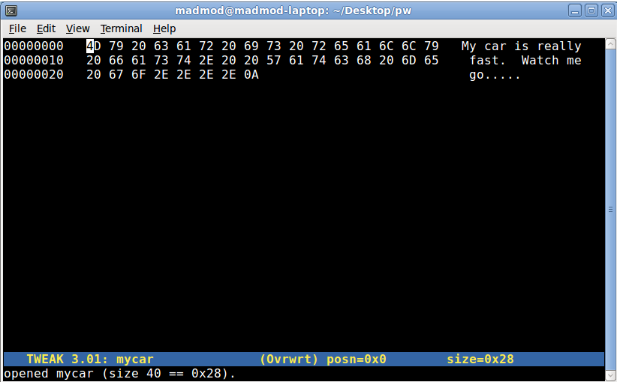
The Hex of the plaintext of mycar
3

Slide 5
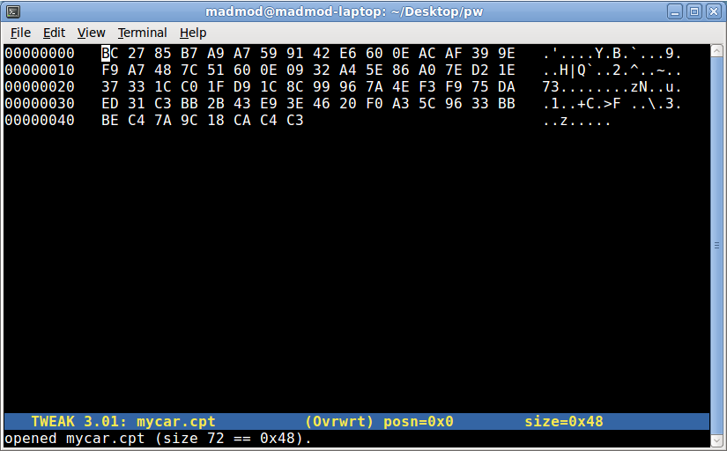
The Hex of the Encrypted mycar
4

Slide 6
Notes on ccrypt excerps from http://ccrypt.sourceforge.net/
5
ccrypt is based on the Rijndael cipher, which is the U.S. government's chosen candidate for the Advanced Encryption Standard (AES, see http://www.nist.gov/aes). This cipher is believed to provide very strong security.
Unlike unix crypt, the algorithm provided by ccrypt is not symmetric, i.e., one must specify whether to encrypt or decrypt. The most common way to invoke ccrypt is via the commands ccencrypt and ccdecrypt.
Encryption and decryption depends on a keyword (or key phrase) supplied by the user. By default, the user is prompted to enter a keyword from the terminal. Keywords can consist of any number of characters, and all characters are significant (although ccrypt internally hashes the key to 256 bits).

Slide 7
Using Tweak to Study Ccrypt
(using a text editor to study plain and encrypted text)
This LibreOffice.org Presentation 'tweakccr.odp' can be downloaded from
http://madmod.com/freebies.html

